Slide 1



Topic name:
intelligent illumination control system for poultry farms
TEAM MEMBERS:
Keesari Sowmya
P.Ravija

Slide 2
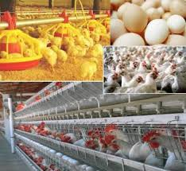
Abstract
Agriculture and poultry are the backbone of any country’s economy. Indeed, there is a strong correlation between agricultural growth and economic prosperity. A wireless sensor network (WSN) is proposed to monitor and measure many poultry environmental parameters such as temperature, humidity, and amount of light. The different sensors are disposed in particular positions in the farm in order to better reveal the realistic information. The collected farming data are sent NodeMCU by different sensors i.e, DHT sensor and LDR. Operating sprinkler’s and fan’s using mobile app connected to NodeMCU would be more easier.

Slide 3
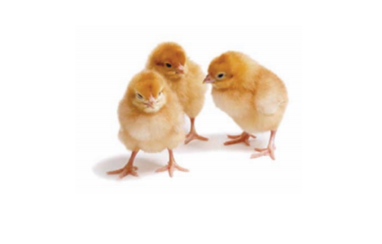
Problem statement
Illumination is one of the key parameters in deciding the breading date of hen’s. Higher illumination causes early breading of hens with smaller size eggs.
Controlling the illumination w.r.t. the breading date and external weather will lead to higher productivity.

Slide 4
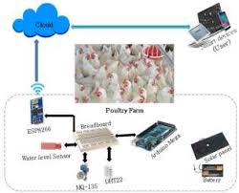
HARDWARE COMPONENTS
NodeMCU
DHT Sensor
Basic Shield
Motor

Slide 5
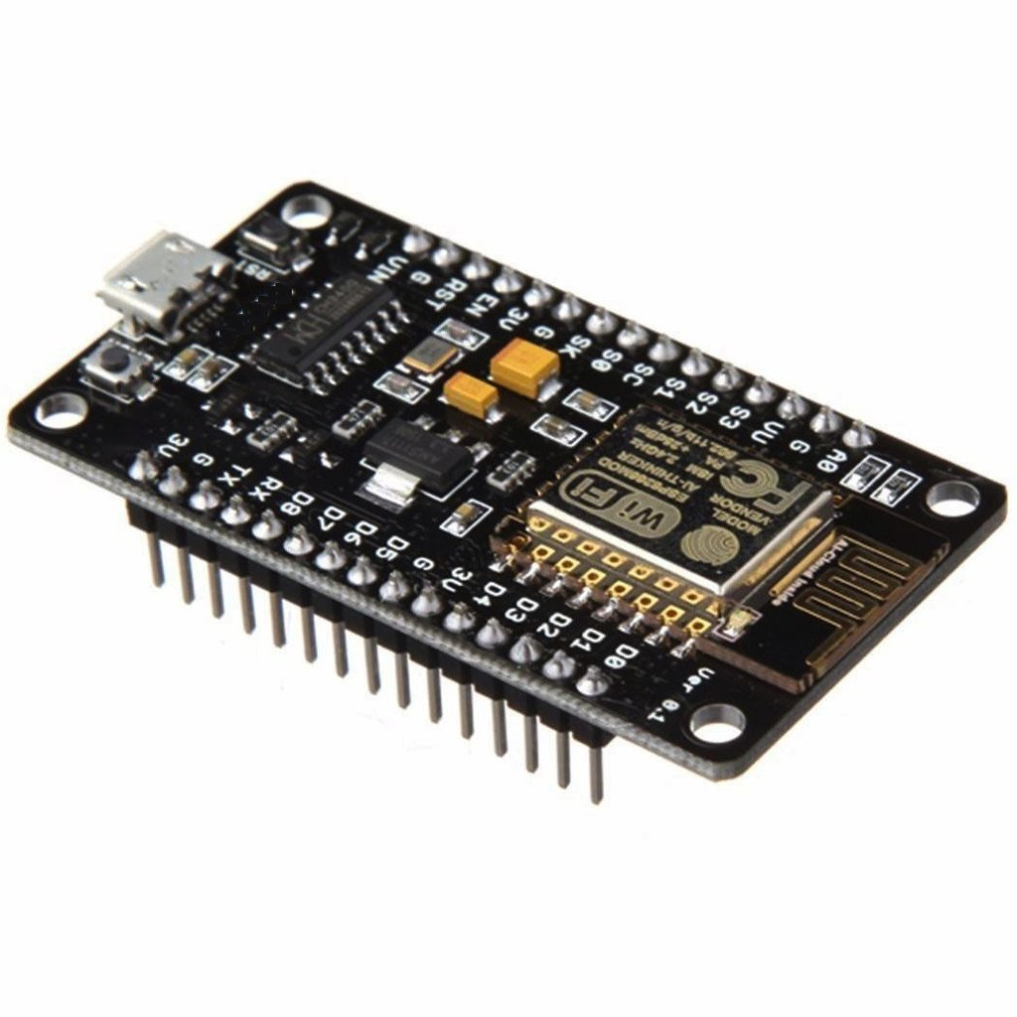
NodeMCU
NodeMCU is an open source IoT platform. It includes firmware which runs on the ESP8266 Wi-Fi SoC from Espressif Systems, and hardware which is based on the ESP-12 module. The term "NodeMCU" by default refers to the firmware rather than the development kits. NodeMCU Development board is featured with WIFI capability, analog pin, digital pins and serial communication protocols. It has 13 GPIO pins

Slide 6
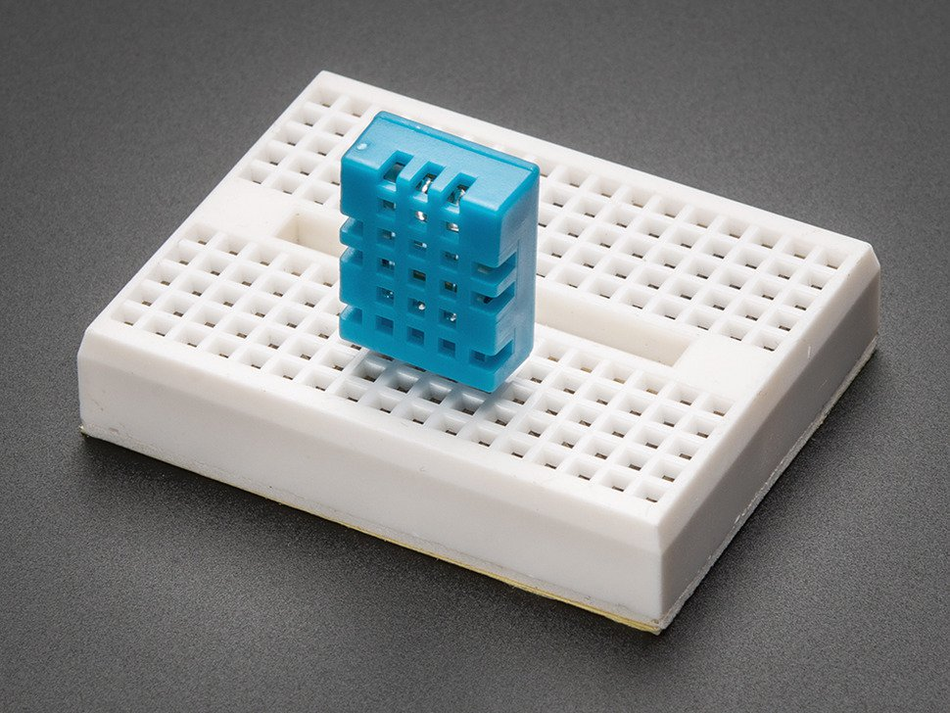
DHT11 Sensor
The DHT11 is a basic, ultra low-cost digital temperature and humidity sensor. It uses a capacitive humidity sensor and a thermistor to measure the surrounding air, and spits out a digital signal on the data pin (no analog input pins needed). Its fairly simple to use, but requires careful timing to grab data. The only real downside of this sensor is you can only get new data from it once every 2 seconds, so when using our library, sensor readings can be up to 2 seconds old.

Slide 7
Block diagram
DHT Sensor
Temperature
Humidity
Mobile App
NodeMCU
Sprinkler on/off
Fan on/off
LDR
LED on/off

Slide 8
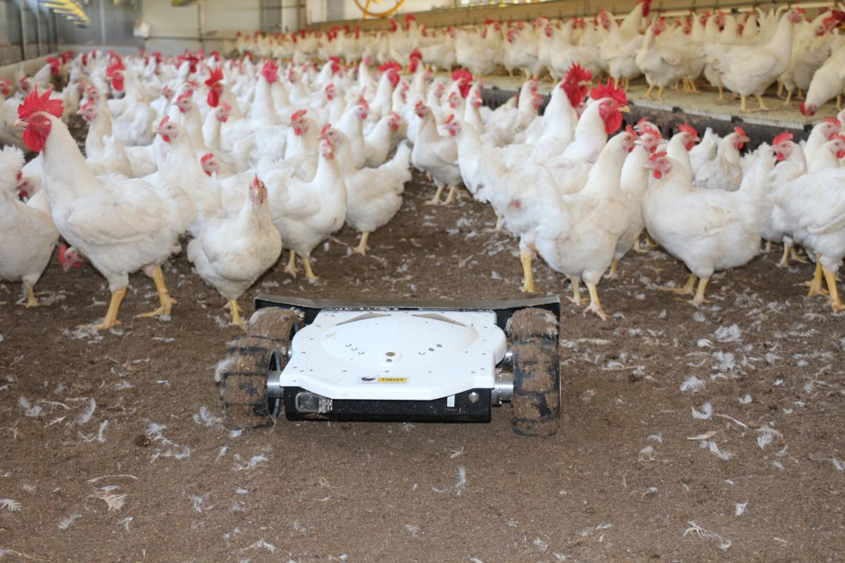
advantages
Increase in production
Safety of hen’s in the poultry farm
Maintaining temperature

Slide 9
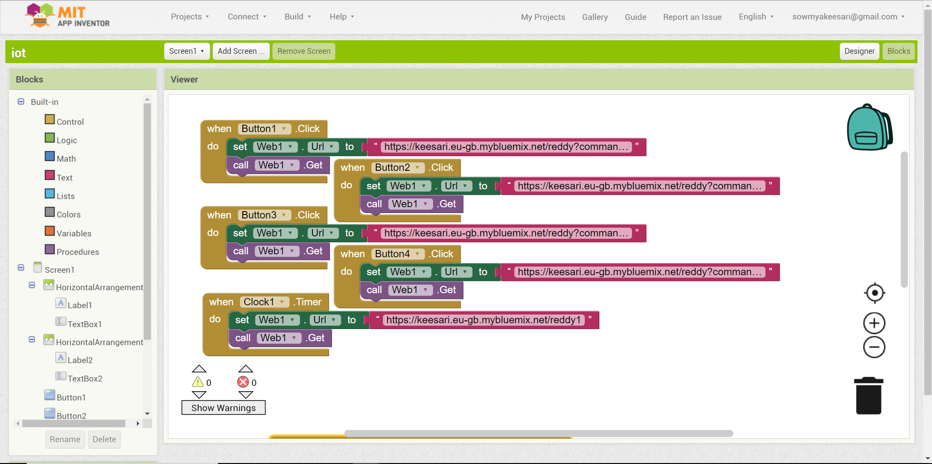

Slide 10
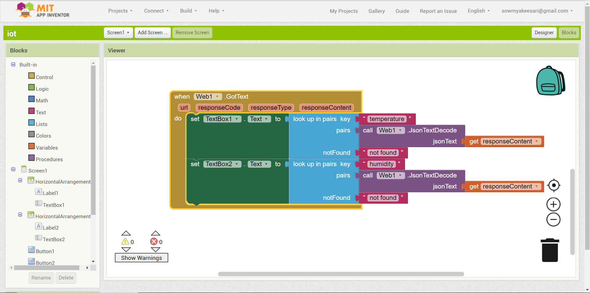

Slide 11
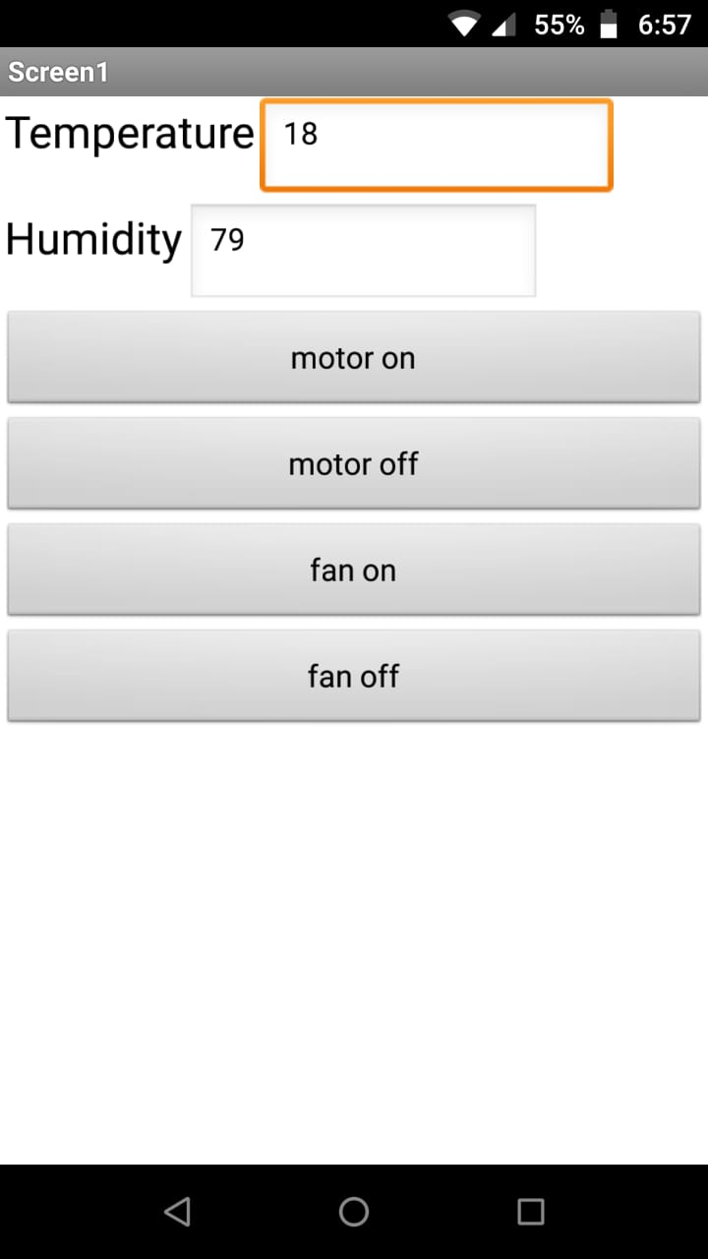
MIT mobile app

Slide 12
Conclusion
The embedded system is an innovative technology for chicken farming, which changes a traditional farm to a “Smart Farm” or “Intelligent Farm”. It also explains the method of Food Control Mechanism for a poultry farm. Threshold values of temperature, lighting, ammonia gas and food are monitor and control by the microcontroller. As well as remote monitoring is done and with the help of this facility, the person in-charge can observe the situation of internal structure of poultry by sitting in a one room as data will be display on a web portal. The intelligent system can reduce cost, time, and labor is highly user friendly to the farmers. This ideal system will improve the human food requirements by improving quality and quantity of chicken. This system

Slide 13
Future Scope
Use UV light in farms to increase Vitamin-D in eggs.
Automating the disposal of waste.
Automatically detecting the diseases of birds by monitoring the weight of the bird.

Slide 14


